Slide 1

Customer Shopping Behavior Analysis
This project analyzes 3,900 customer purchases to uncover insights into spending patterns, preferences, and subscription behavior, guiding strategic business decisions.

Slide 2
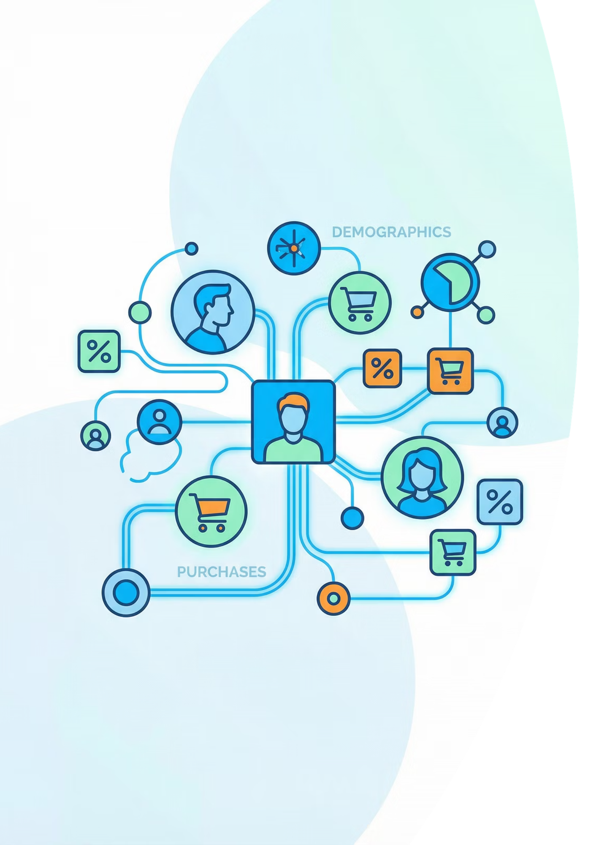
Project Overview & Dataset Summary
Project Goal
Uncover insights into spending patterns, customer segments, product preferences, and subscription behavior.
Dataset Size
3,900 rows, 18 columns, covering diverse product categories.
Key Features
Demographics, purchase details, shopping behavior, and subscription status.
Missing Data
37 values in the "Review Rating" column were handled.

Slide 3
Exploratory Data Analysis (Python)
01
02
03
Data Loading & Exploration
Missing Data Handling
Column Standardization
Imported dataset with pandas; checked structure and summary statistics.
Imputed missing "Review Rating" values using median per product category.
Renamed columns to snake_case for improved readability.
04
05
Feature Engineering
Database Integration
Created 'age_group' and 'purchase_frequency_days' columns.
Loaded cleaned data into PostgreSQL for SQL analysis.

Slide 4
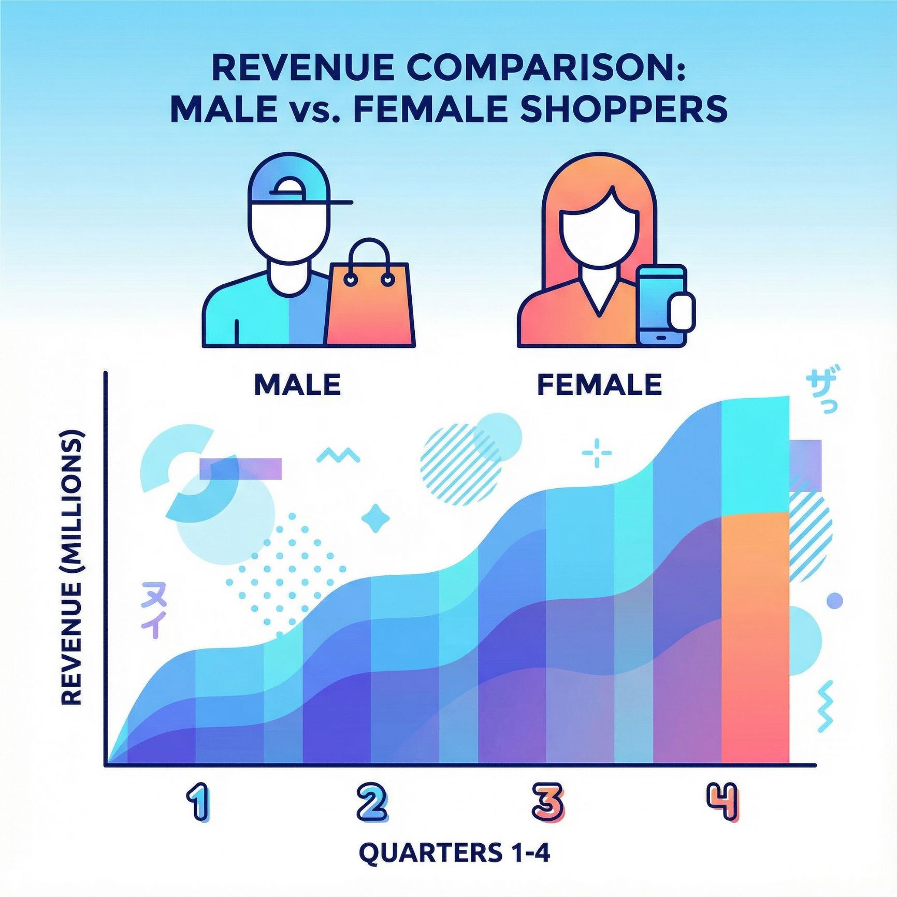
Revenue by Gender & High-Spending Discount Users
Revenue by Gender
High-Spending Discount Users
Female
75,191
Identified 839 customers who used discounts but spent above average.
Male
157,890

Slide 5


Top Products & Shipping Insights
1
Top 5 Products by Rating
Gloves (3.86), Sandals (3.84), Boots (3.82), Hat (3.80), Skirt (3.78).
2
Shipping Type Comparison
Express shipping users have a higher average purchase amount ($60.48) than Standard ($58.46).

Slide 6
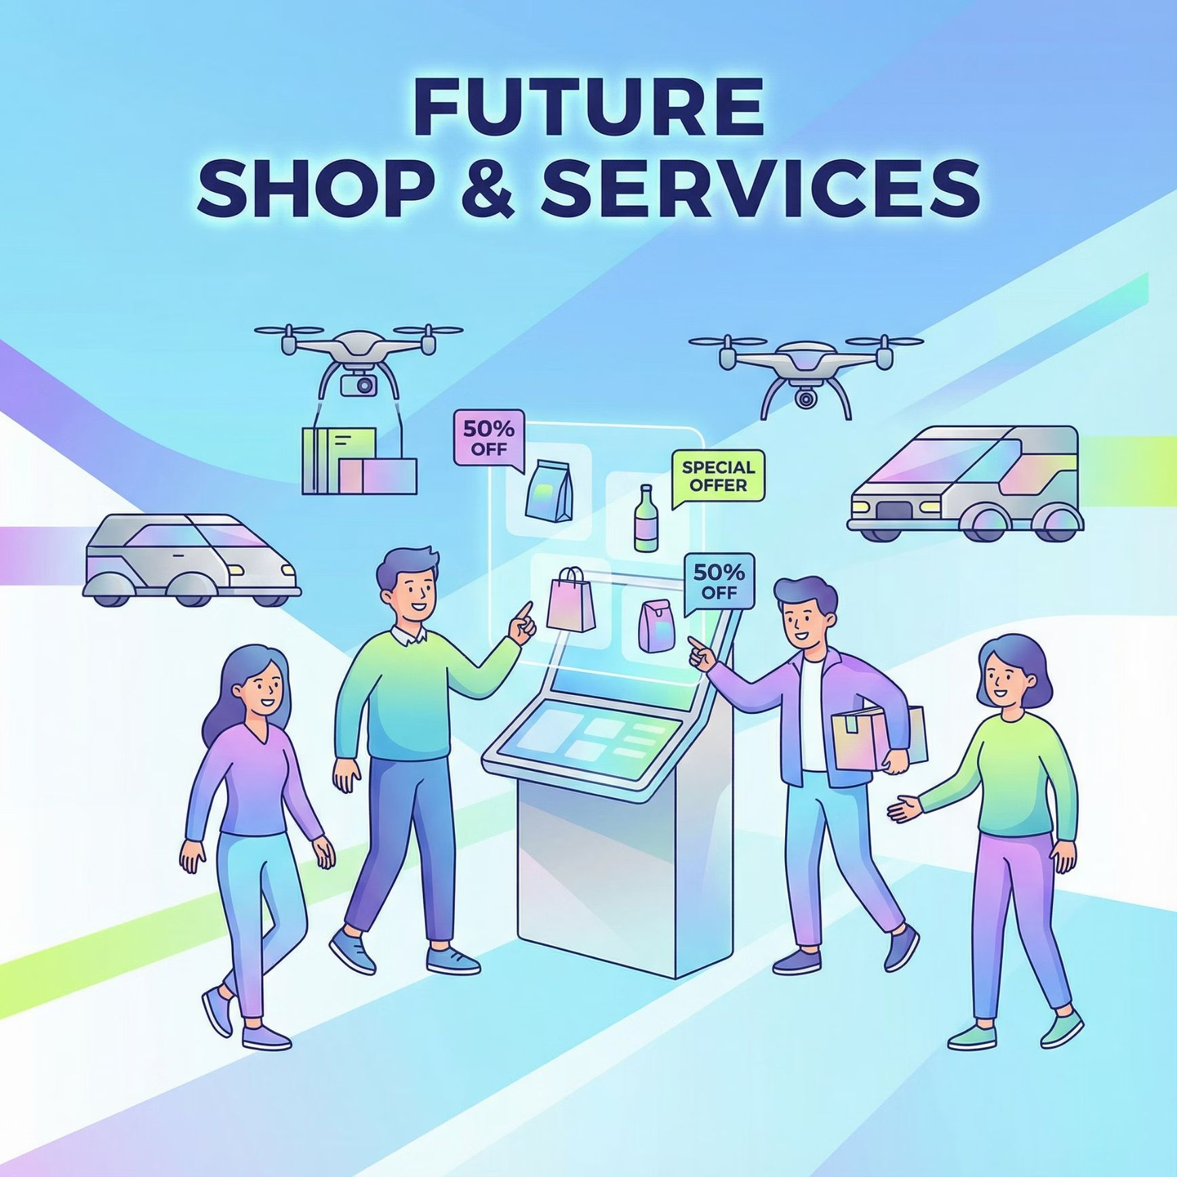
Subscription Impact & Discount-Dependent Products
Subscribers vs. Non-Subscribers
Discount-Dependent Products
Yes
1053
59.49
62645.00
Hat (50%), Sneakers (49.66%), Coat (49.07%), Sweater (48.17%), Pants (47.37%) had the highest discount rates.
No
2847
59.87
170436.00

Slide 7
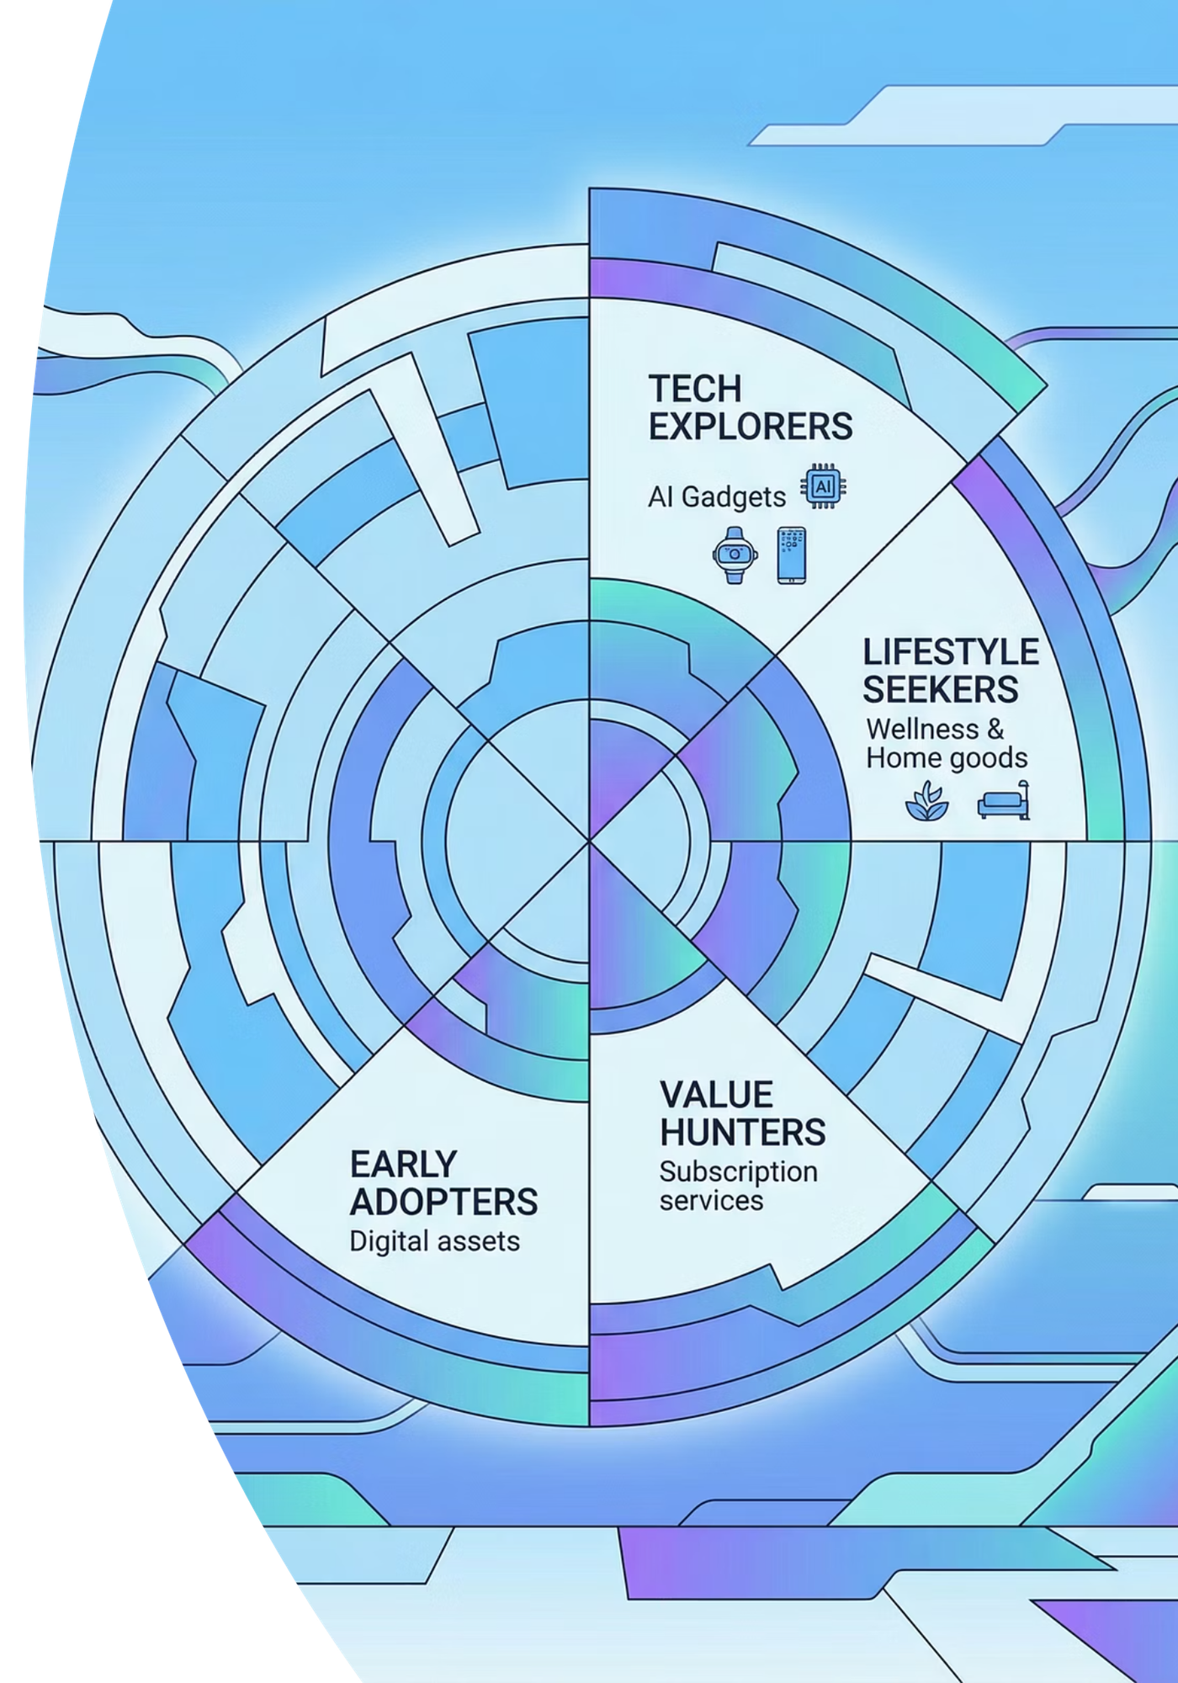

Customer Segmentation & Top Products by Category
Loyal Customers
3116 customers
New Customers
83 customers
Returning Customers
701 customers
Top products per category include Jewelry, Blouse, Sandals, and Jacket.

Slide 8

Repeat Buyers & Revenue by Age Group
Repeat Buyers & Subscriptions
Revenue by Age Group
958 repeat buyers (customers with >5 purchases) are subscribers, while 2518 are not.
Young Adult
62143
Middle-aged
59197
Adult
55978
Senior
55763

Slide 9
Power BI Dashboard
An interactive Power BI dashboard was created to visually present all key insights and findings from the analysis.

Slide 10
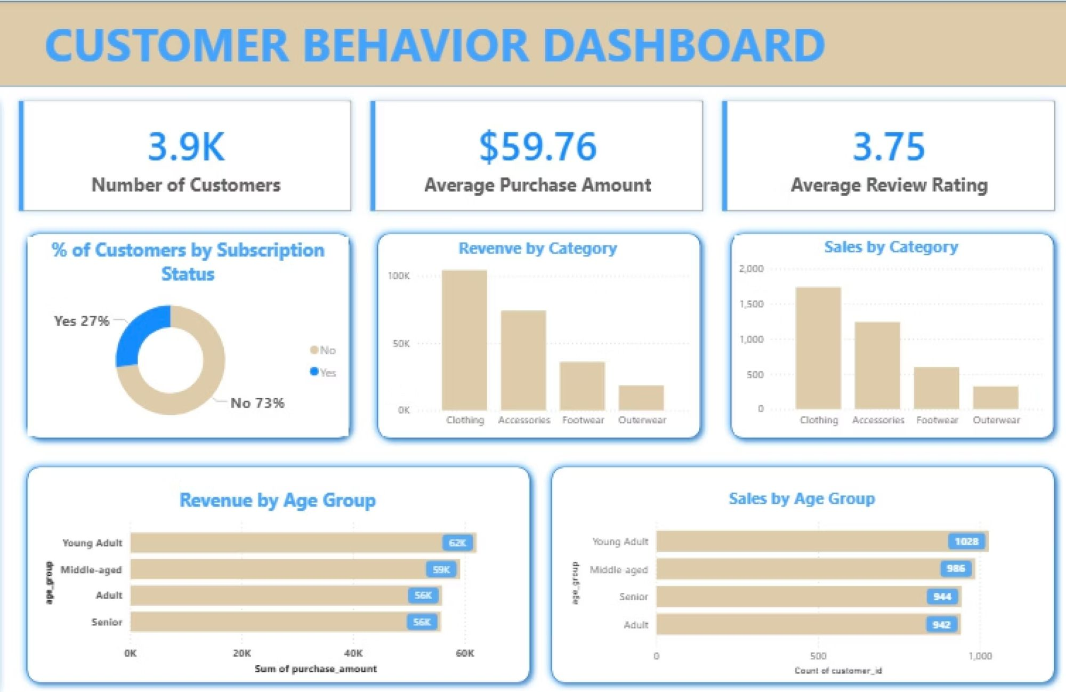

Slide 11





Business Recommendations
Boost Subscriptions
Promote exclusive benefits to increase subscriber base.
Customer Loyalty Programs
Reward repeat buyers to foster loyalty and move them to the "Loyal" segment.
Review Discount Policy
Balance sales boosts with margin control for optimal profitability.
Product Positioning
Highlight top-rated and best-selling products in marketing campaigns.
Targeted Marketing
Focus efforts on high-revenue age groups and express-shipping users.

